Slide 1


Slide 2
SIVA SUBRAMANIAN
Technical Lead (UI @ BFSI)

Slide 3
What is Angular ?
1) Angular is an open-source JavaScript Framework maintained by Google for building Single Page Applications (SPAs).
2) Angular is a framework for building client applications in HTML, CSS and Typescript ( that compiles to JavaScript ).
3) It has changed the way we develop client side applications, by providing the possibilities to apply the best practices usually applied on server side like modular programming, separation of concerns, testability and many other, on client side.

Slide 4
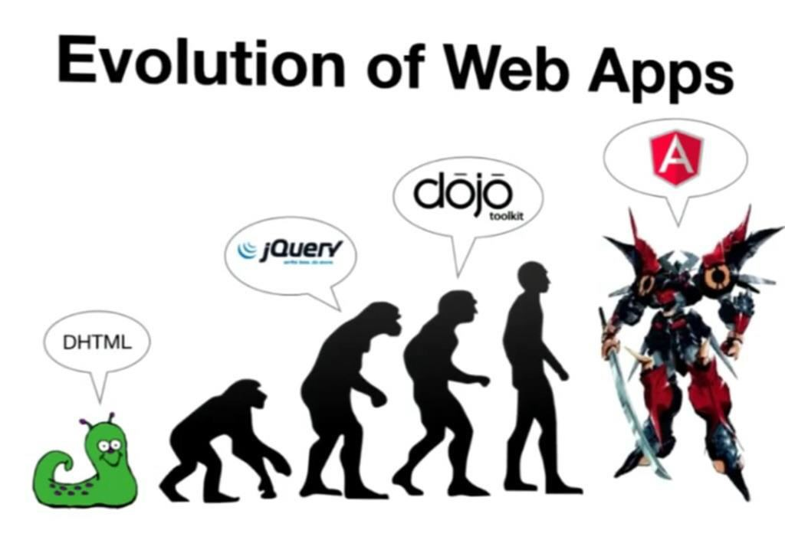

Slide 5

VS

Slide 6
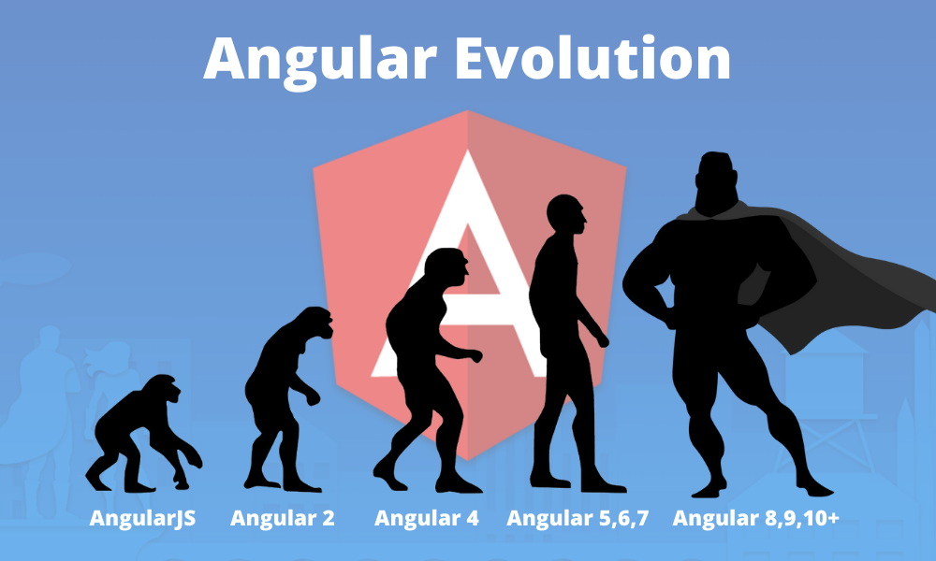

Slide 7
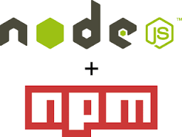

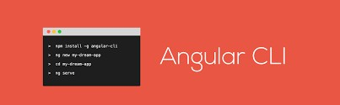

Angular Install the Environment

Slide 8
Angular Install the Environment
VS Code: Text editor (or any other that you prefer)
Node.js + npm: dependence management
Angular CLI: Command Line Interfaces for angular
TypeScript: The language of angular 10

Slide 9
Angular Install the Environment
After install npm, install typescript and angular cli using the npm of node.js
~ npm install –g typescript@latest
~npm install –g @angular/cli@10.0.0

Slide 10
Angular Create a new Project
~ ng new NewProjectName
~npm install / If copy new source code to run

Slide 11
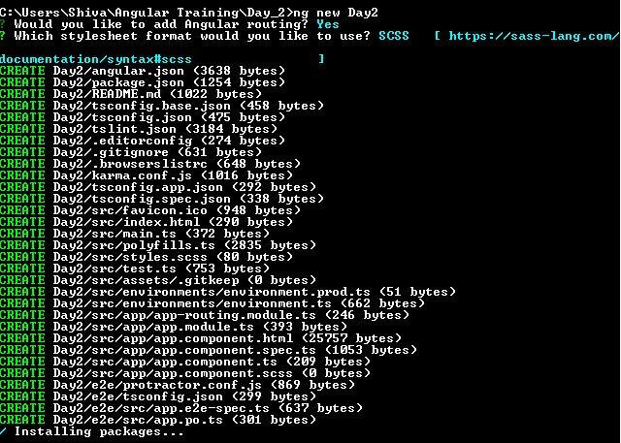
Angular Create a new Project

Slide 12
Angular Run & Test Project
Running the project
ng server inside of project folder
open the browser on http://localhost:4200
UnitTest the project
ng test inside of project folder
Karma & Jasmin test case will execute

Slide 13
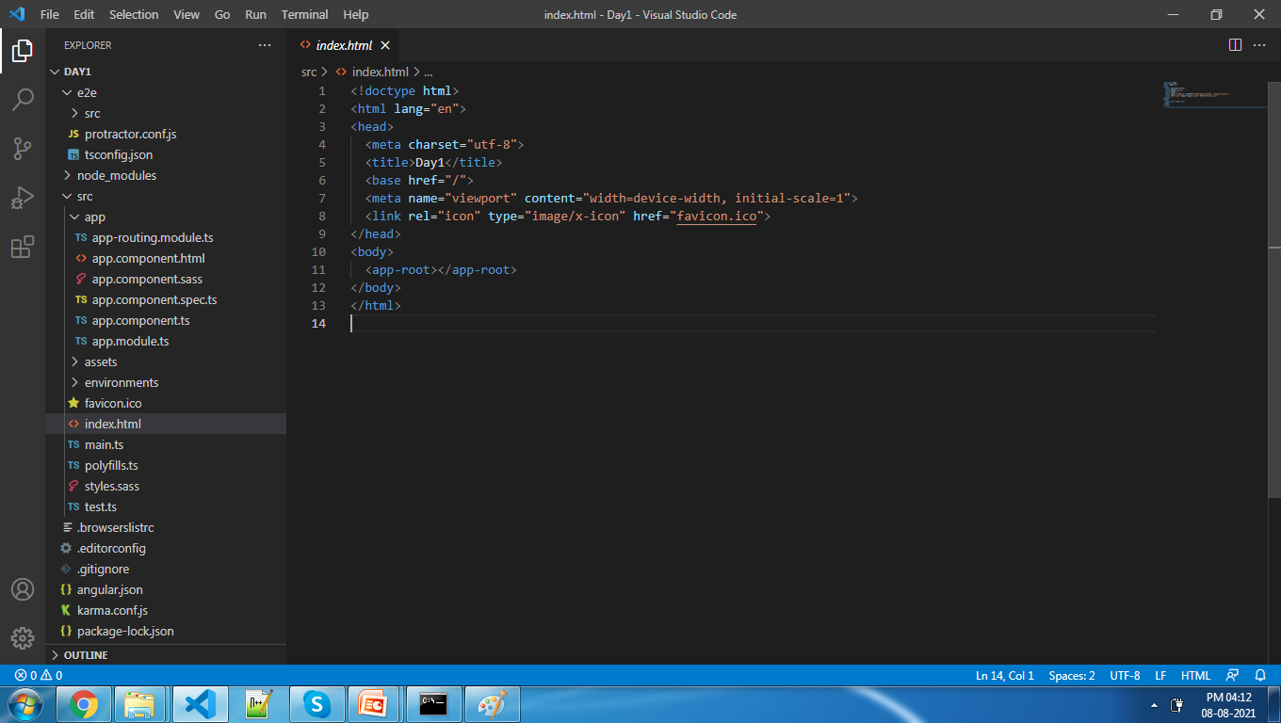
Angular Create a new Project

Slide 14
















Two-way Data Binding
ONE WAY DATA B INDING TWO WAY DATA B INDING
VIEW
TEMPLATE
Change in view Updates model
change in model Updates
VIEW
One- time Merge
CONTINUOUS UPDATE
TEMPLATE
Model
Model
Change in model Updates view

Slide 15
Templates
Static Template
Dynamic Data
Final View

Slide 16
Templates
Templates are plain old HTML
Extended HTML Vocabulary to contain instructions on how to combine model data into view
Its NOT HTML string manipulation (one of the major differences from other frameworks)

Slide 17
View
What the users see
HTML Template that is merged with the model and finally rendered into the browser DOM

Slide 18
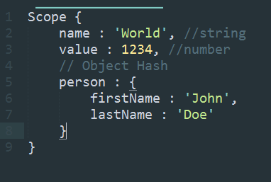
Model
Data that is merged with the HTML template to produce views

Slide 19
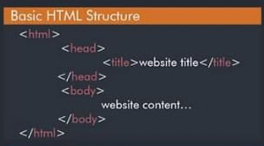
HTML5- Basic Structure

Slide 20
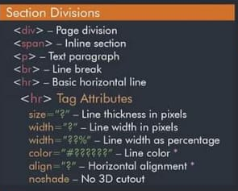
HTML5-Section Divisions

Slide 21
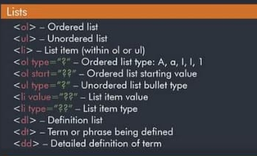
HTML5-List

Slide 22
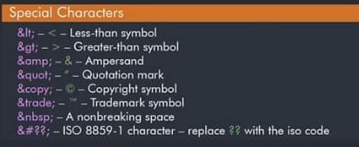
HTML5-Special Characters

Slide 23
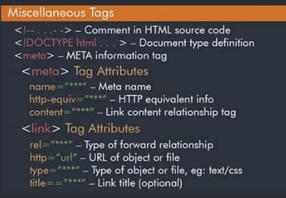
HTML5-Other Tags

Slide 24
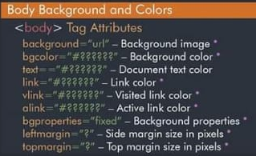
HTML5-Body Background

Slide 25
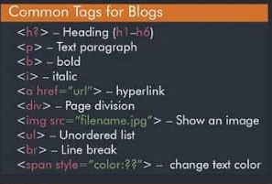
HTML5-Common Tags

Slide 26
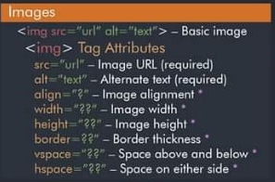
HTML5-Image Tags

Slide 27
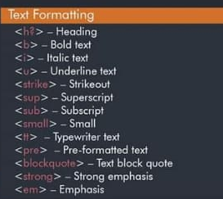
HTML5-Text Formatting Tag

Slide 28
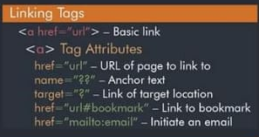
HTML5-Linking Tag

Slide 29
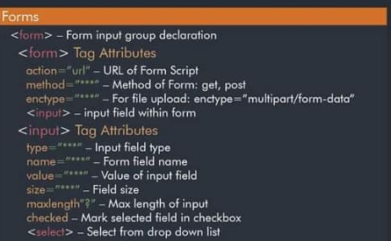
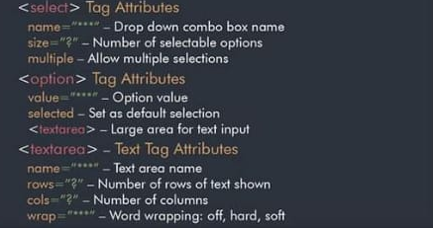
HTML5- Form Tag

Slide 30
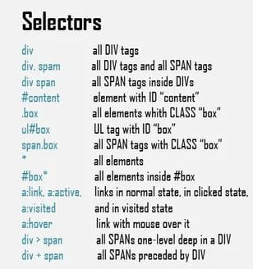
CSS3 - Selectors

Slide 31
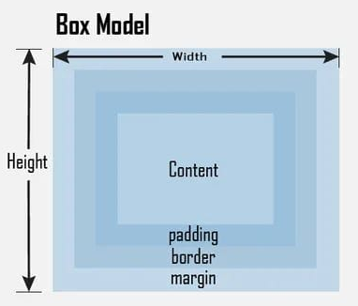
CSS3 – Box Model

Slide 32
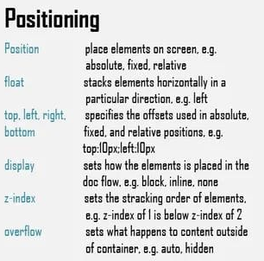
CSS3 – Positioning

Slide 33
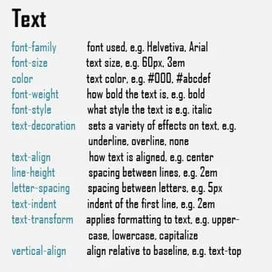
CSS3 – Text

Slide 34
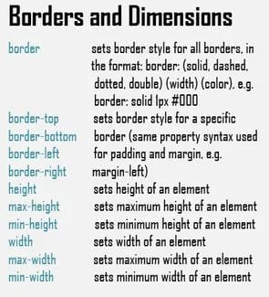
CSS3 – Border and Dimension

Slide 35
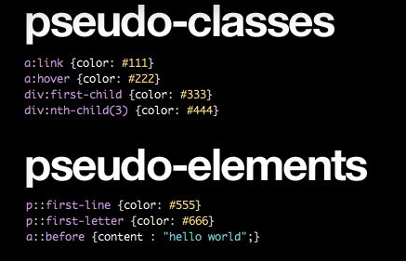
CSS3–Pseudo-class&Elements

Slide 36
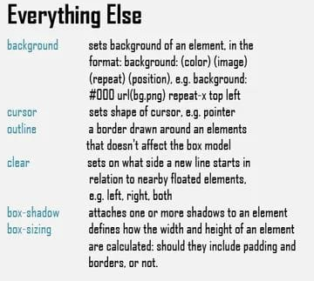
CSS3 – Others

Slide 37
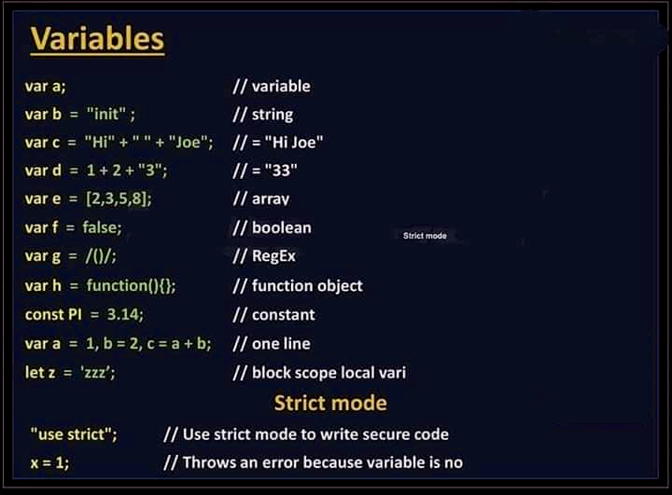
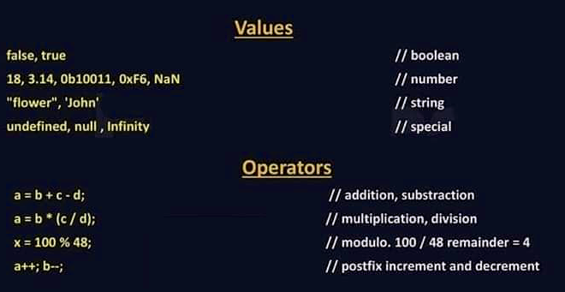
JavaScript– Variables

Slide 38
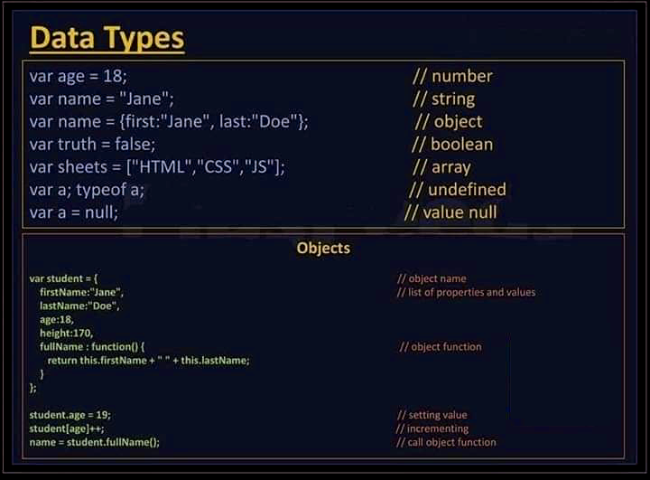
JavaScript– Data Types

Slide 39
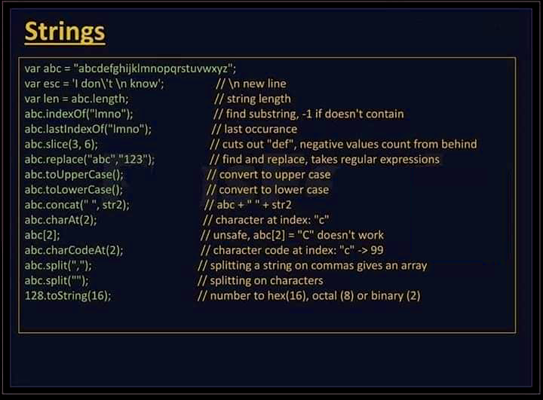
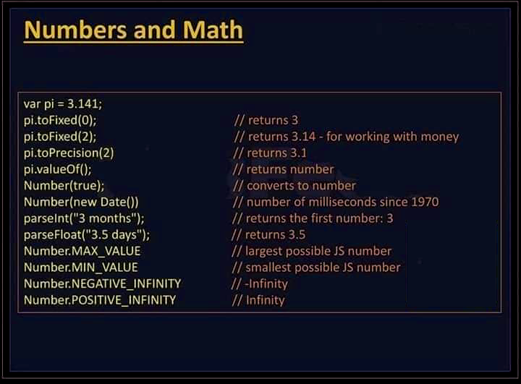
JavaScript– Strings&Numbers

Slide 40
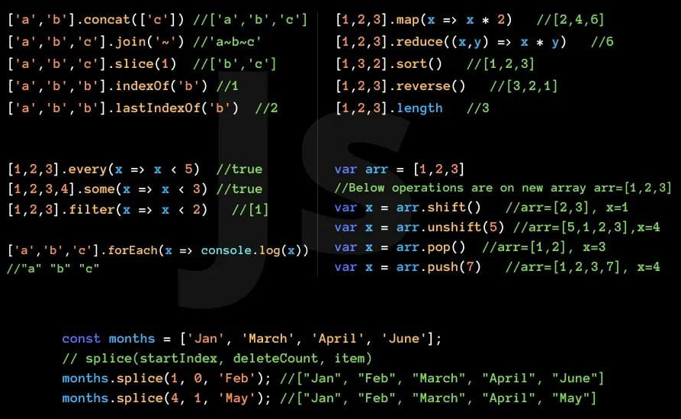
JavaScript–Arrays

Slide 41
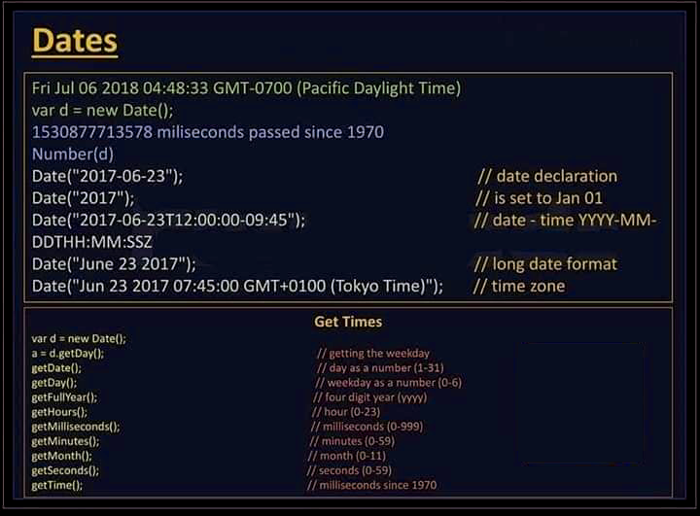
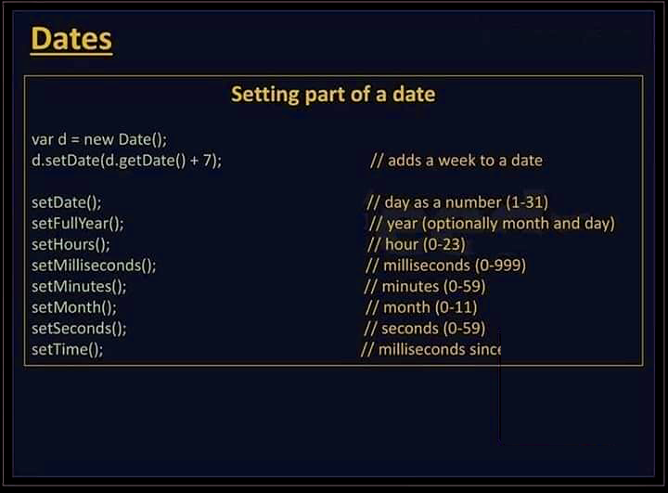
JavaScript–Dates

Slide 42
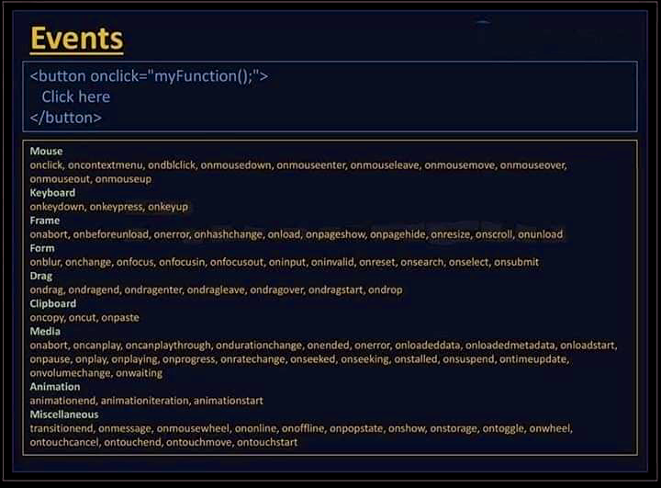
JavaScript–Events

Slide 43
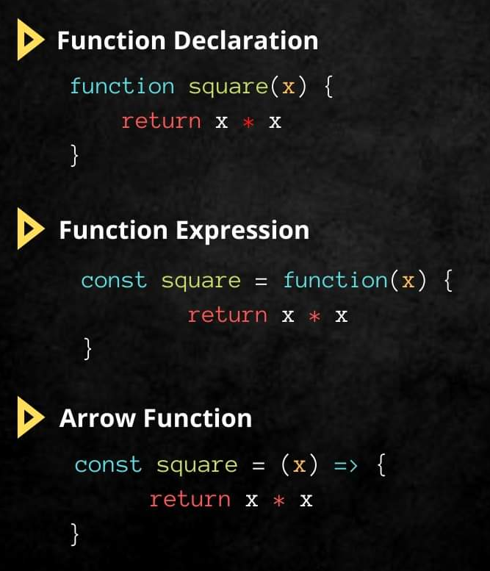
JavaScript–Functions

Slide 44
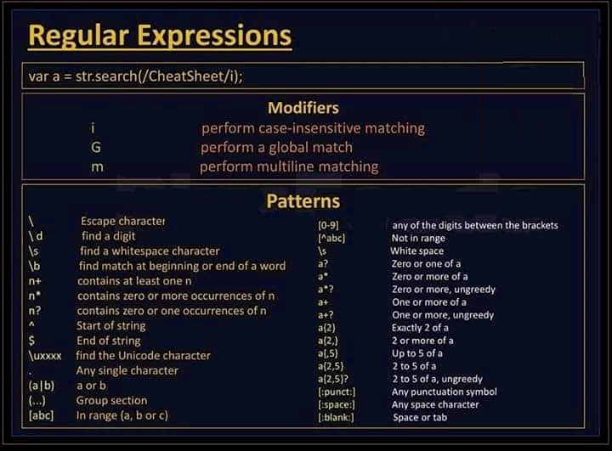
JavaScript–Regular Expressions

Slide 45
That’s All For Today Day-1 !!
Questions?

Slide 46
Thank You
shiva1991@live.com

